Slide 1
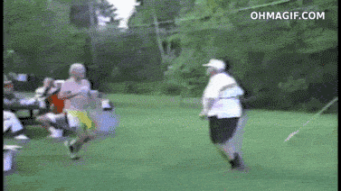
This lesson
Conservation of linear momentum

Slide 2
Momentum
What makes an object hard to stop?
Is it harder to stop a bullet, or a truck travelling along the highway?
Are they both as difficult to stop as each other?

Slide 3
Momentum
It makes sense to assume that a bullet travelling twice as fast would be twice as hard to stop, and a truck twice the mass would also be twice as hard to stop.

Slide 4
Momentum
Momentum is a useful quantity to consider when thinking about "unstoppability". It is also useful when considering collisions and explosions. It is defined as
Momentum (kg.m.s⁻¹) = Mass (kg) x Velocity (m.s⁻¹)
p = mv

Slide 5
An easy example
A lorry/truck has a mass of 10 000 kg and a velocity of 3 m.s⁻¹. What is its momentum?
Momentum = Mass x velocity
= 10 000 x 3
= 30 000 kg.m.s⁻¹.

Slide 6
Law of conservation of momentum
In an isolated system, momentum remains constant.
This means in a collision between two objects, momentum is conserved (total momentum stays the same). i.e.
Total momentum before the collision = Total momentum after

Slide 7
A harder example!
A car of mass 1000 kg travelling at 5 m.s⁻¹ hits a stationary truck of mass 2000 kg. After the collision they stick together. What is their joint velocity after the collision?
First, sketch the situation.

Slide 8
A harder example!
Before
2000kg
1000kg
5 m.s⁻¹
Momentum before = 1000x5 + 2000x0 = 5000 kg.m.s⁻¹
After
Combined mass = 3000 kg
V m.s⁻¹
Momentum after = 3000v

Slide 9
A harder example
The law of conservation of momentum tells us that momentum before equals momentum after, so
Momentum before = momentum after
5000 = 3000v
V = 5000/3000 = 1.67 m.s⁻¹

Slide 10
Momentum is a vector
Momentum is a vector, so if velocities are in opposite directions we must take this into account in our calculations

Slide 11
An even harder example!
Snoopy (mass 10kg) running at 4.5 m.s⁻¹ jumps onto a skateboard of mass 4 kg travelling in the opposite direction at 7 m.s⁻¹. What is the velocity of Snoopy and skateboard after Snoopy has jumped on?
I love physics

Slide 12
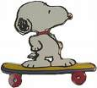
An even harder example!
Because they are in opposite directions, we make one velocity negative
10kg
-4.5 m.s⁻¹
4kg
7 m.s⁻¹
Momentum before = 10 x -4.5 + 4 x 7 = -45 + 28 = -17 kg.m.s⁻¹
14kg
v m.s⁻¹
Momentum after = 14v

Slide 13
An even harder example!
Momentum before = Momentum after
-17 = 14v
V = -17/14 = -1.21 m.s⁻¹
The negative sign tells us that the velocity is from left to right (we choose this as our “negative direction”)

Slide 14
“Explosions” - recoil

Slide 15
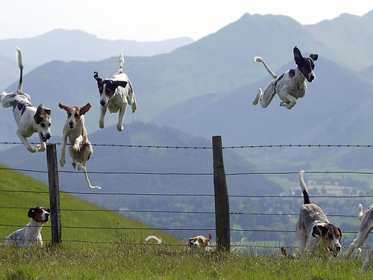
What if we all jump at once?
http://www.youtube.com/watch?v=jHbyQ_AQP8c&feature=relmfu

Slide 16
Explosions
Conservation of momentum always applies in isolated systems, even during explosions. However, be aware that kinetic energy CAN change.
2.4 Gun demo for Mr Porter by Sean Walden of Houston Texas

Slide 18
Momentum and kinetic energy
1) p = mv and 2) E_{k} = ½mv²
Substituting v = p/m from 1) into 2)
E_{k} = ½m(p/m)² = ½m(p²/m²) = ½p²/m = p²/2m
E_{k} = p²/2m

Slide 19
Let’s try some questions!
2.4 Simple Momentum questions

Slide 20
This lesson
Impulse and force-time graphs
Newton’s 2nd law expressed in terms of rate of change of momentum

Slide 21
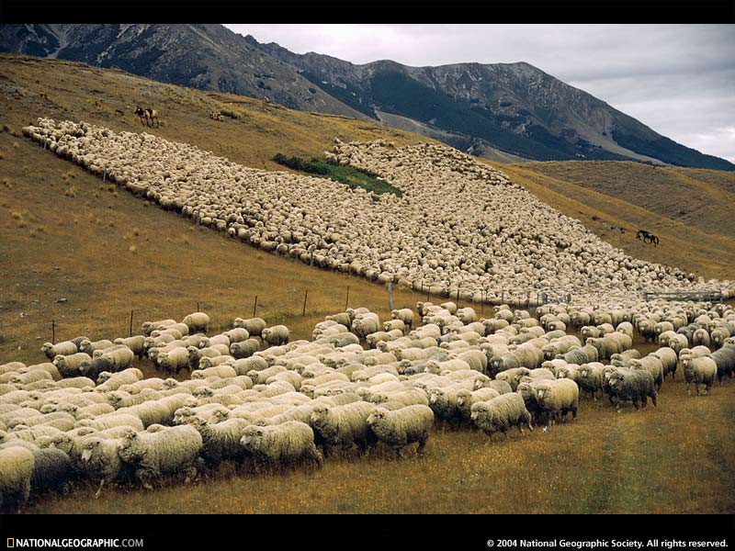
Let’s follow Mr Porter to throw and catch some eggs!
Notes:
Go outside with eggs and lab coats. Pair students off and they have to throw and catch eggs whilst gradually increasing the distance between each pair. To catch the egg without breaking it you obviously have to reduce the force on the egg by taking more time to catch it!

Slide 22
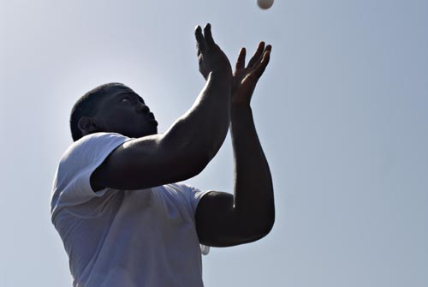
Catching eggs
To reduce the force on the eggs (and so not breaking it), you had to increase the TIME it took the egg to stop to reduce the force on the egg.

Slide 23
Newton’s 2nd law
F = ma
F = m(v-u)/t
F = (mv – mu)t =
F = rate of change of momentum
F = Δp/Δt
F = Δp/Δt

Slide 24
Impulse
F = Δp/Δt
FΔt = Δp
FΔt = Δp
The quantity FΔt is called the IMPULSE
Impulse = change in momentum

Slide 26
Units
Impulse is measured in N.s (Ft)
or kg.m.s⁻¹ (change in momentum)

Slide 27
5 m/s
-3 m/s
Note; For a ball bouncing off a wall, don’t forget the initial and final velocity are in different directions, so you will have to make one of them negative.
In this case mv – mu = -3m -5m = -8m

Slide 28
Example
After being hit, a golf ball of mass 45.93 g reaches a speed of 94 m.s⁻¹. What impulse was given to the ball? If the ball was in contact with the club head for 0.2 ms, what was the average force given to the ball whilst in contact with the club head?

Slide 29
Example
After being hit, a golf ball of mass 45.93 g reaches a speed of 94 m.s⁻¹. What impulse was given to the ball? If the ball was in contact with the club head for 0.2 ms, what was the average force given to the ball whilst in contact with the club head?
Impulse = FΔt = Δp = mv – mu
Impulse = (45.93 x 10⁻³ x 94) – 0 = 4.32 Ns

Slide 30
Example
After being hit, a golf ball of mass 45.93 g reaches a speed of 94 m.s⁻¹. What impulse was given to the ball? If the ball was in contact with the club head for 0.2 ms, what was the average force given to the ball whilst in contact with the club head?
Impulse = FΔt = 4.32 Ns
F = 4.32/0.2 x 10⁻³ = 21600 N

Slide 31
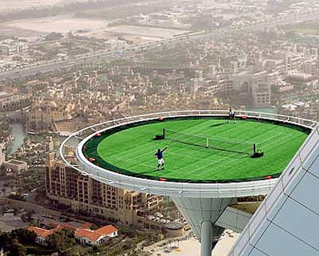
Another example
A tennis ball (0.3 kg) hits a racquet at 3 m.s⁻¹ and rebounds in the opposite direction at 6 m.s⁻¹ . What impulse is given to the ball?

Slide 32
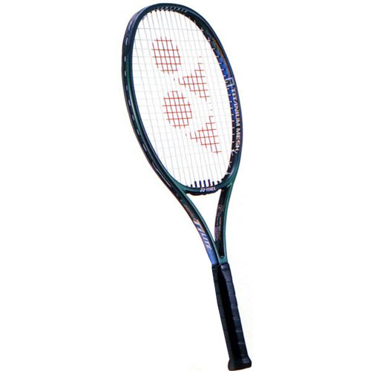
Another example
A tennis ball (0.3 kg) hits a racquet at 3 m.s⁻¹ and rebounds in the opposite direction at 6 m.s⁻¹ . What impulse is given to the ball?
3 m/s
-6 m/s

Slide 33
Another example
A tennis ball (0.3 kg) hits a racquet at 3 m.s⁻¹ and rebounds in the opposite direction at 6 m.s⁻¹ . What impulse is given to the ball?
Impulse = Δp = mv – mu
= 0.3x-6 – 0.3x3
= -2.7kg.m.s⁻¹
3 m/s
-6 m/s

Slide 36
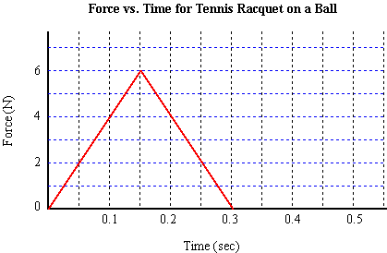
Area under a force-time graph = impulse
Area = impulse = average force x time

Slide 37
Now let’s try some fun questions!
2.4 Impulse questions
But first let’s watch this!
http://www.youtube.com/watch?v=bKLrj3UFqQI

Slide 39
This lesson
Elastic and inelastic collisions
Lots of practice mechanics questions from real IB papers!

Slide 40
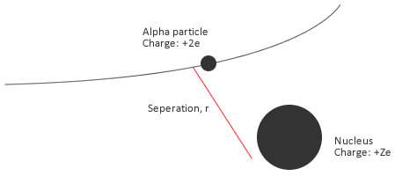
Elastic collisions
No loss of kinetic energy (only collisions between subatomic particles) After an elastic collison the bodies continue to move separately.

Slide 41
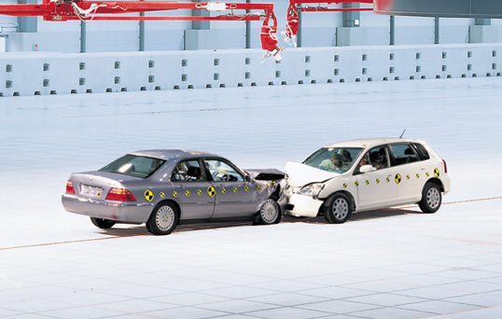
Inelastic collisions
Some kinetic energy lost (but momentum stays the same!) The bodies may stick together.

Slide 42
Momentum
The kinetic energy may change, but the total momentum of the system (if no external forces act) stays the same.
Notes:
An exploding rocket is a common example used in multiple choice questions. There IS an increase in kinetic energy but momentum stays the same.

Slide 43
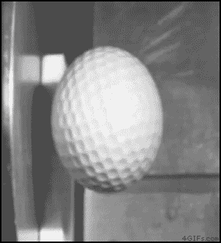
An MIT video!
https://www.youtube.com/watch?v=3fi7KmVyAW8

Slide 44
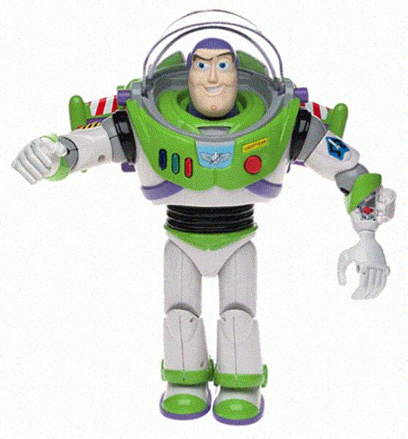
Buzz Lightyear has a mass of 160kg in his space suit. He flies straight at Zurg at 40m.s⁻¹. Zurg has 20kg more mass that Buzz and can only fly at 30m.s⁻¹, and he is doing this – straight towards Buzz! Assuming they stick together in one lump, calculate:
a the speed and direction of Buzz and Zurg immediately after impact;
b the loss of kinetic energy due to the impact.
Using standard notation:
m_{B} = 160kg u_{B} = 40m.s⁻¹
m_{Z} = 180kg u_{Z} = - 30m.s⁻¹
a Initial momentum = (160 x 40) - (180 x 30)
= 1000kg.m.s⁻¹
Final momentum = (160 + 180) v
Using principle of conservation of momentum:
1000 = 340v
v = 2.94m.s⁻¹ in the direction in which Buzz was initially travelling.
b KE before impact = (0.5 x 160 x 40 x 40) + (0.5 x 180 x -30 x -30)
= 209kJ
KE after impact = (0.5 x 340 x 2.94 x 2.94)
= 1.5kJ
Loss of KE = 207.5kJ

Slide 45
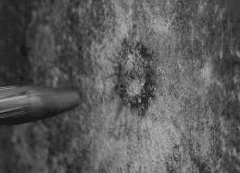
Notes:
Elastic or inelastic?

Slide 46
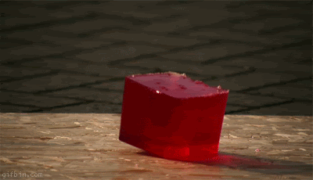
Notes:
Elastic or inelastic?

Slide 47
IB Questions
You have now finished Topic 2 Mechanics. Let’s try some “real” IB past papers questions on Mechanics.
Notes:
Important now to do LOTS of past paper mechanics questions.

